Slide 1
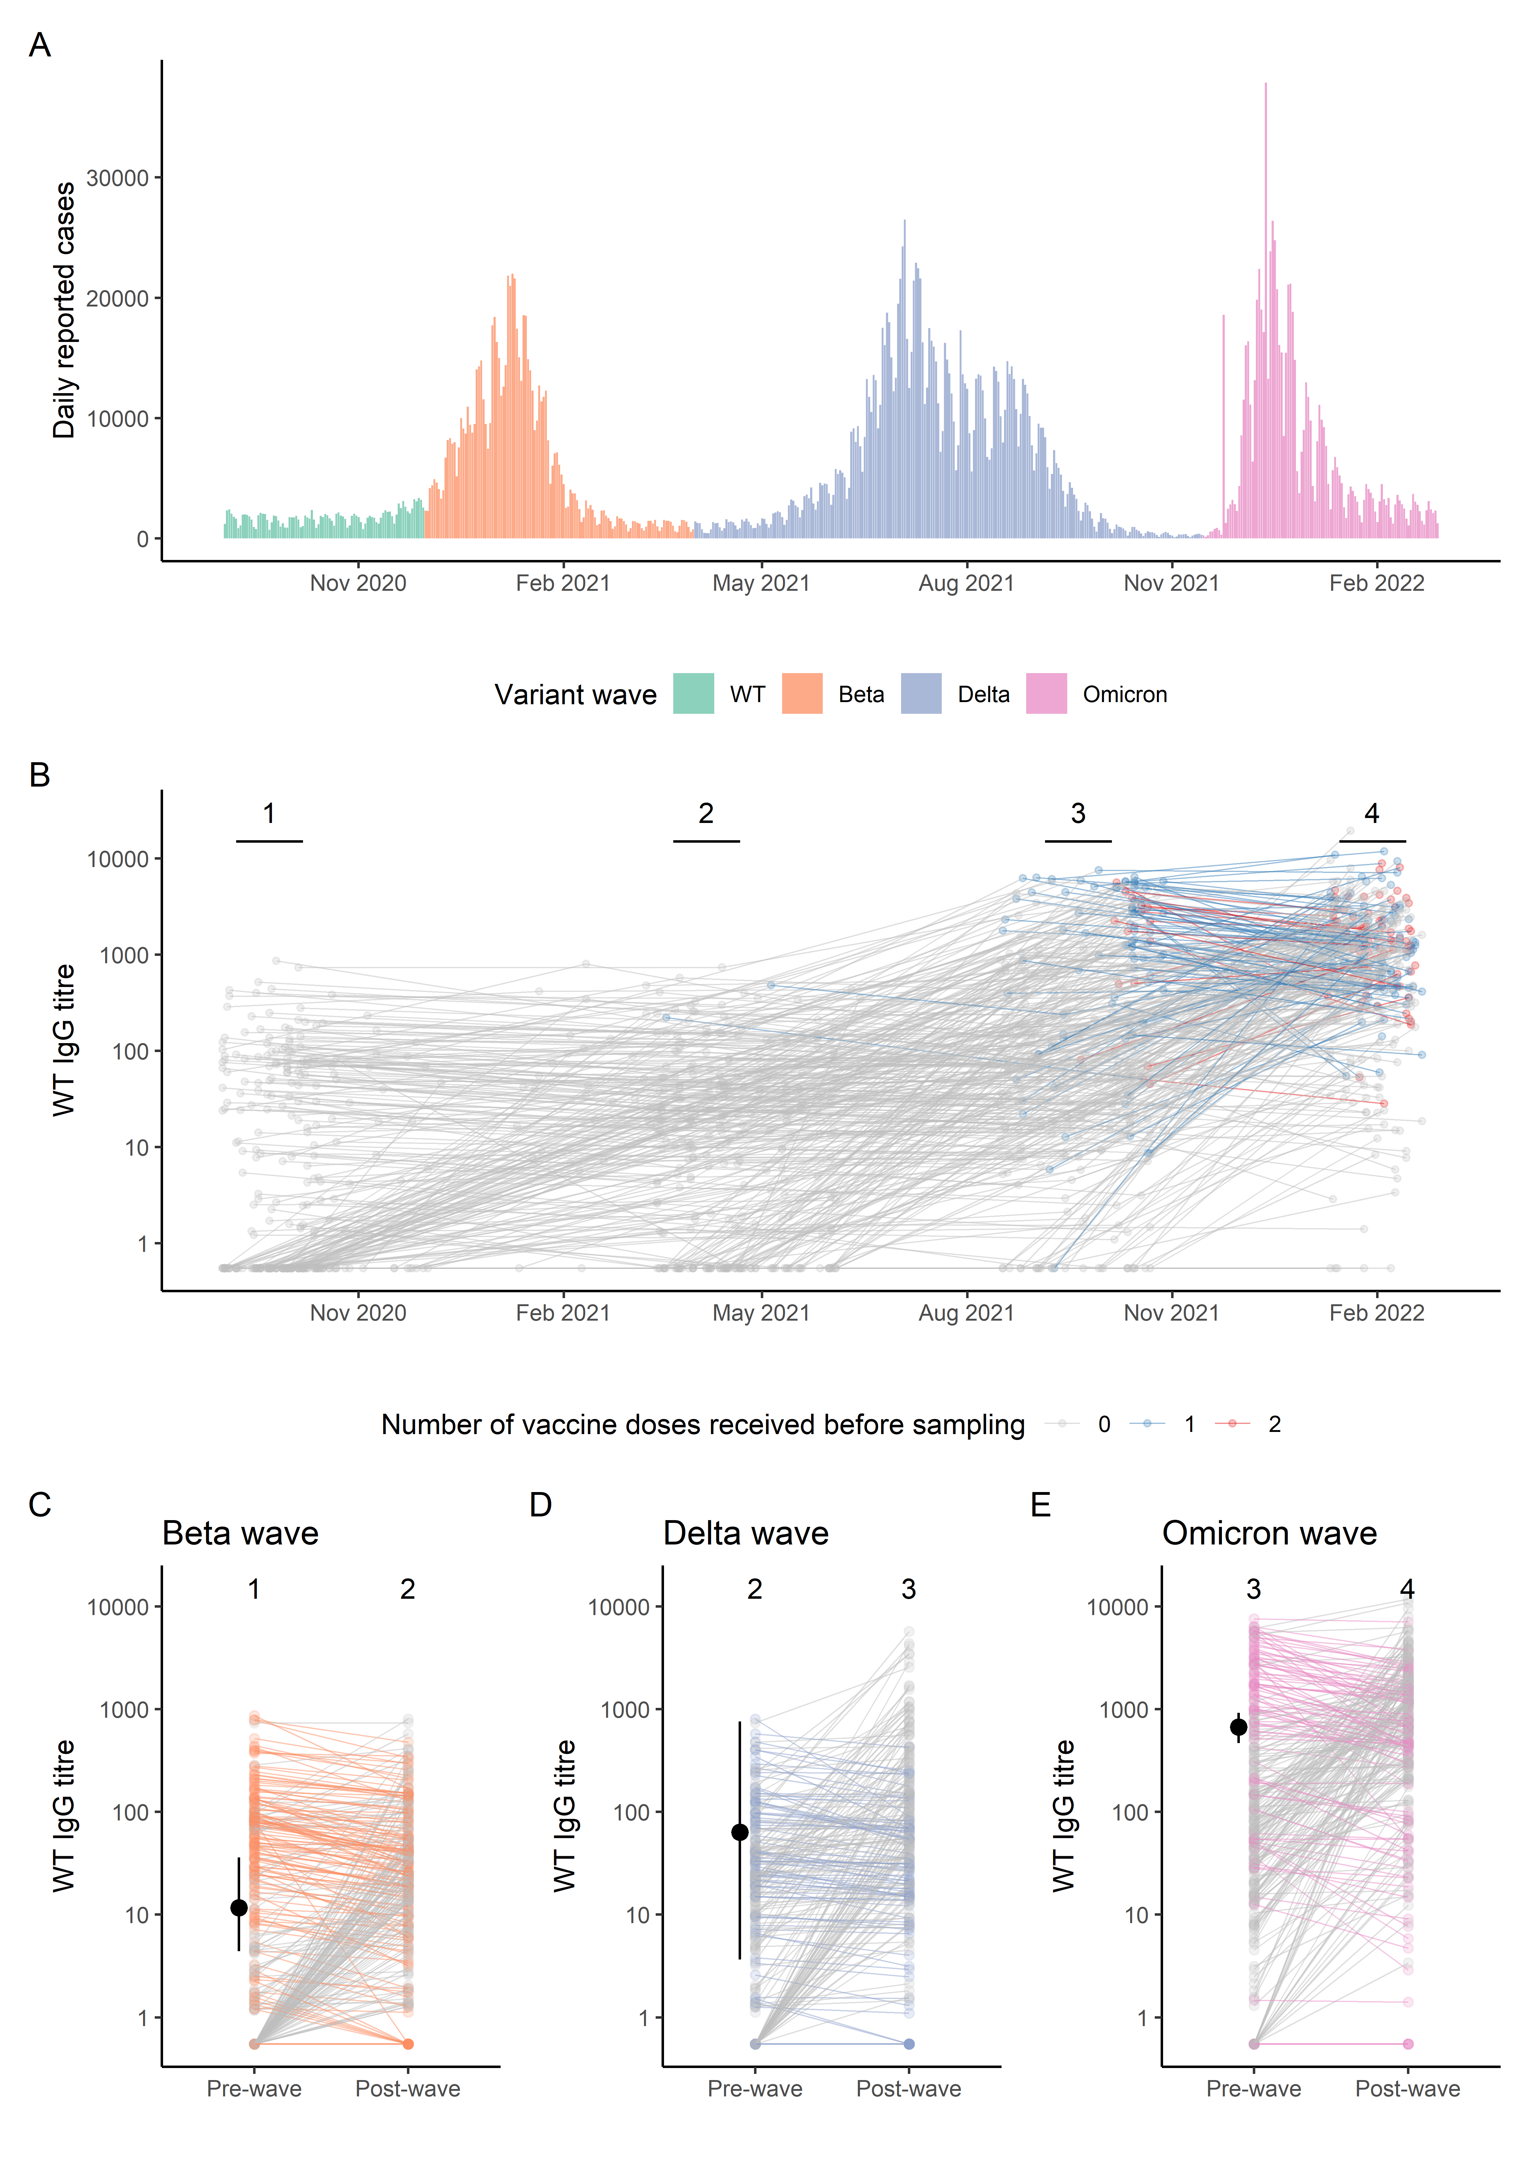
Fig 1
Figure 1

Slide 2
REV Figure 2

